Slide 1
JavaServerPages
Introduction to JSP
JSP Architecture
JSP Tags
Implicit Objects
JSP with Java Beans
Custom Tags in JSP

Slide 2
Introduction to JSP
Java Server Pages (JSP) is a Java Soft standard specification for combining Java with HTML to provide dynamic content in web pages.
The Java Server Pages technology enables the authoring of Web pages that create dynamic content easily.

Slide 3
What is a JSP Page
A JSP page is a text-based document that describes how to process a HttpRequest to create a
HttpResonse.

Slide 4
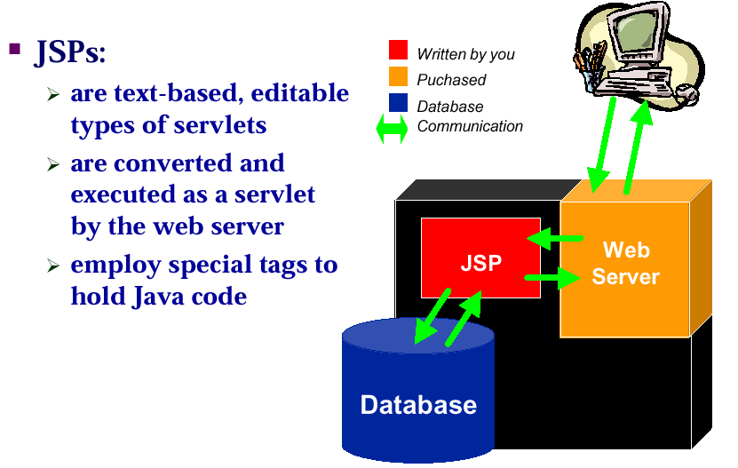
What is a JSP Page

Slide 5
JSP Architecture
Web Client
Web/Application Server
Client
Request
JSP Engine
JSP
Servlet
Response
Servlet Engine

Slide 6
Translating and Executing JSP Pages
A JSP page is executed by a JSP container, which is installed on a Web Server or Web enabled Application Server.
The JSP container delivers requests from a client to a JSP page and responses from the JSP page to the client.

Slide 7
Translating and Executing JSP Pages (Cont..)
A JSP page is executed by a JSP container, which is installed on a Web Server or Web enabled Application Server.
JSPcontainer creates an implementation class dynamically for each JSP page.
The JSP page implementation class implements Servlet and the Servlet protocol will be used to deliver requests.

Slide 8
JSP Tags
Directives
  Page Directives
  Include Directive
  Taglib Directives
Scripting Elements
  Declaration Tag
  Scriptlet
  Expression

Slide 9
JSP Tags (cont…)
Standard Actions
  JSP Forward Tag
  JSP Include Tag
  JSP Param Tag

Slide 10
Page Directives
<%@ page import =“java.util.*”,”java.io.*” %>
<%@ page contentType=“text/html” %>
<%@ page isErrorPage=“false” %>
<%@ page errorPage=“XXXX.jsp” %>
<%@ page buffer=“16k|none” %>
<%@ page autoFlush=“true” %>
<%@ page langauge=“java” %>
<%@ page isThreadSafe=“true” %>
<%@ page session=“true” %>

Slide 11
Scripting Elements
Declaration Tag
Syntax:-
  <%! Declaration of variables and Methods %>
  All Variables Declarations should terminate with semicolon (;)
  All Variables declared in this tag will become global variables.

Slide 12
Scripting Elements(cont…)
Scriptlet Tag
Syntax:-
  <% Java Code Fragment %>
  <% Java Code That need to be Embedded in JSP Page %>
  Any Java Programming Code We Have to write Under this tag.

Slide 13
Scripting Elements(cont…)
Expression Tag
Syntax:-
  <%= Any Valid Java Expression %>
Example:
  <%! int x1=3; %>
  <%! int x2=6; %>
  <%! int x3=9; %>
Average= <%= (x1+x2+x3)/3.0 %>
The Result of this tag directly send to client browser

Slide 14
Standard Actions
can use, modify and/or create objects.
  <jsp:useBean>
  <jsp:setProperty>
  <jsp:getProperty>
  <jsp:include>
  <jsp:plugin>
  <jsp:forward>

Slide 15
<jsp:useBean>
Locates or instantiates a Bean with a specific name
JSP Syntax
    <jsp:useBean id="beanInstanceName“ class="package.class" />
Examples
    <jsp:useBean id="cart" class="session.Carts" />

Slide 16
<jsp:setProperty>
  Sets a property value or values in a Bean
  JSP Syntax
    <jsp:setProperty name="beanInstanceName" property="propertyName" value="{ string | <%= expression %> }" />
  Examples
    <jsp:setProperty name="mybean“ property="username” value="Steve“ />

Slide 17
<jsp:getProperty>
Gets the value of a Bean property so that you can display it in a result page.
JSP Syntax
  <jsp:getProperty name="beanInstanceName“ property="propertyName" />
Examples
  <jsp:useBean id="calendar" class="employee.Calendar" />

Slide 18
<jsp:include>
Includes either a static or dynamic file in a JSP file.
JSP Syntax
<jsp:include page="relativeURL " />
Examples
<jsp:include page="copyright.html" />

Slide 19
<jsp:forward>
Forwards a client request to an HTML file, JSP file, or servlet for processing.
JSP Syntax
<jsp:forward page=" relativeURL" />
Examples
<jsp:forward page="/servlet/login"/>

Slide 20
<jsp:plugin>
Downloads a plugin to the client Web browser to execute an applet or Bean
JSP Syntax
  <jsp:plugin type="bean|applet" code="classFileName“ codebase="classFileDirectoryName"
  </jsp:plugin>
Examples
  <jsp:plugin type=applet code="Molecule.class" codebase="/html">
  </jsp:plugin>

Slide 21
Examples
One Example on Page directives.
Two Examples on Scripting Elements.
Two Examples on Standard actions.

Slide 22
Implicit Objects
request
response
session
application
exception
pageContext
out
Note:- Two Examples Covering all Implicit objects.

Slide 23
Custom Tags
JSP Supports defining user defined tags in JSP
To define CustomTag in JSP We will have to write the following files
Tag Handler Class(Java Prog.)
TagLib Descriptor File(XML File)

Slide 24
Custom Tags
JSP Supports defining user defined tags in JSP
To define CustomTag in JSP We will have to write the following files
Tag Handler Class(Java Prog.)
TagLib Descriptor File(XML File)

